Slide 1
Naked Eye Astronomy
There are speaker’s notes in this presentation to help you follow along and serve as a reference to these slides
Getting Oriented to the Night Sky
Jim Tomney
HAL Monthly Meeting
November 2024
Notes:
The fundamental prerequisite to participating in observing the night sky is to learn the sky. Where’s the Big Dipper? Is Jupiter out tonight? Can I see Orion? These and many other questions come to mind as you set out to explore the night sky. My objective this evening is to provide some pointers to help you on the journey of getting comfortable with the night sky. While you may believe that today’s GOTO telescope technology allows you to skip learning the sky, I’d counter that only when you have this under your belt should you consider the next step (binoculars or a telescope).
(In the following slide notes, [X] indicates you should click your mouse to animate the slide to reveal its next component)

Slide 2
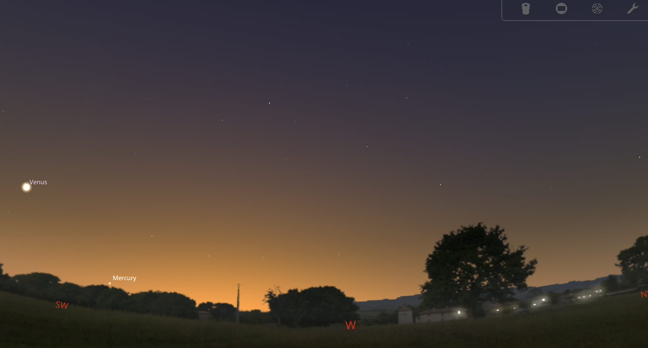
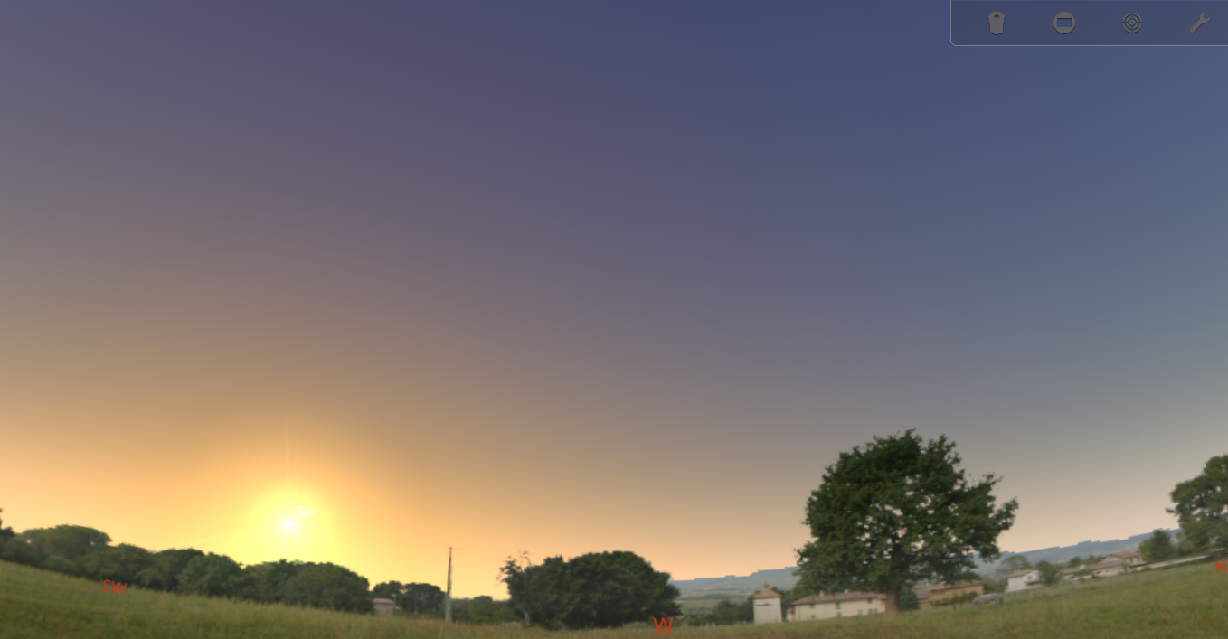
Diurnal (Daily) Motion
Notes:
Let’s start by talking about how the sky changes as we look at it. For this discussion I am using a desktop planetarium software called Stellarium. It’s available for free as a download or you can use the online interface. Planetarium software allows you to simulate the appearance of the night sky. Here we see the sky for our location on the evening of Nov 21, 2024, about an hour before sunset. One of your first steps is to identify the cardinal directions (N-E-W-S) from your location. We all know that the Sun sets in the west and rises in the east, but have you months, that position from your home. Go out and make an intentional effort to identify “West”, taking note that at this time of year the Sun does not set due West but rather a bit left of it.
[X] As the Sun sets, we enter twilight where the sky is still relatively bright and only the brighter objects emerge. There are various stages of twilight (Civil, Nautical, and Astronomical) that are defined by how far below the horizon the Sun lies. Astronomical twilight (18˚) signals that the sky no longer is being illuminated by the Sun – it is as dark as it is going to get.
Right now, and for the next several months, the first thing to emerge (other than the Moon if it is in the sky) will be Venus in the SW, to the left of where the Sun set. But planets move in their orbits, and in a few months, Venus won’t be visible after sunset but rather seen in the pre-dawn sky.

Slide 3
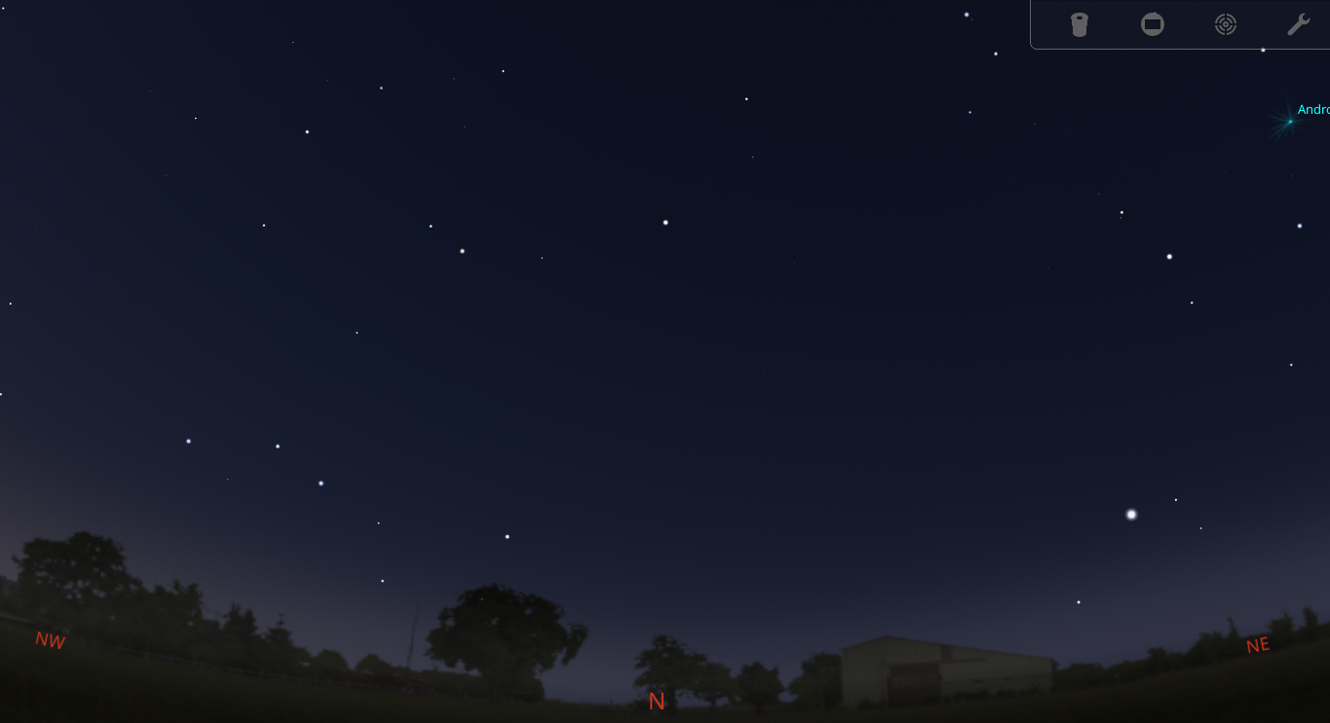
Notes:
With full darkness upon us let’s turn 90 degrees to the right so that we are facing north. The view of stars may look something like this simulation which factors in that our area’s light pollution hides many of the fainter stars.
Long ago, mankind modern-day the idea of constellations – grouping the stars into familiar patterns representing people, animals, and things that were part of their culture. Of course, their imaginations were quite inventive, and modern-day observers might wonder what they were smoking when they saw some of these fanciful things among the stars! Our task is to identify some of these to help in our orientation to the sky.
When facing north a common destination to locate would naturally be the North Star, a.k.a. Polaris. Most people have heard of it, but many also associate it as being a brilliant beacon. If that were true, you might be thinking that the bright star at the lower right is it. But no, Polaris is not special because it is bright but because it appears stationary in the sky; it barely moves during the night nor during the entire year. Any time of night, during any time of the year, once you identify Polaris you can step outside and reliably find it in that same spot. No other star can make that claim.

Slide 4
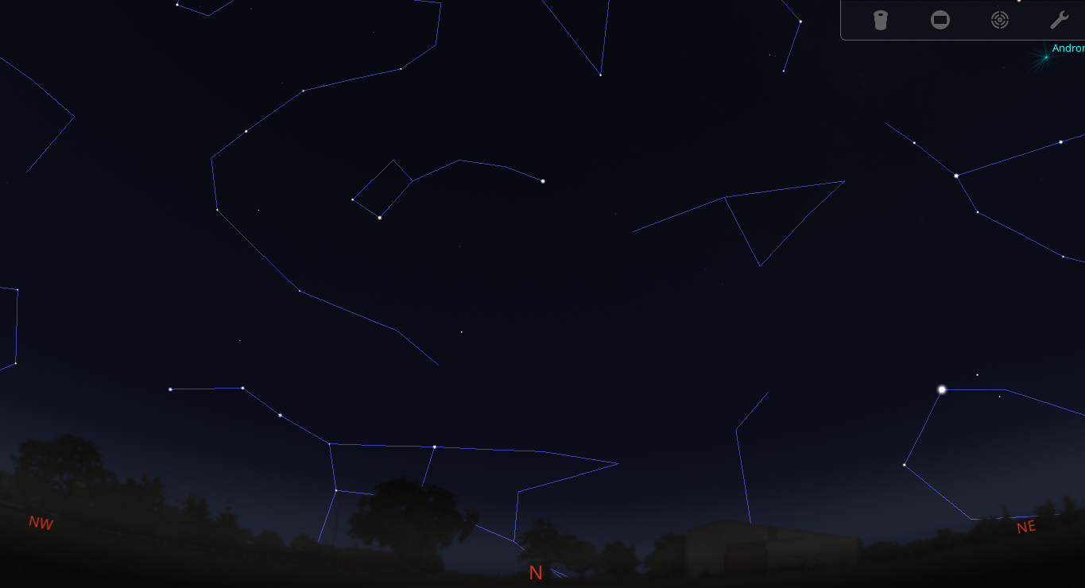
Notes:
How about now? Adding in the constellation lines you may notice that the Big Dipper is skimming the northern horizon. In fact, in our simulated view, part of the bowl is obscured by a tree, blocking one of the pointer stars. The fact is that late Fall-Winter in the early evening is a challenging time to find the Big Dipper as it lies low in the north, often blocked from view.
[X] But, if you can see it, those outer bowl stars will in fact lead you to Polaris. And there it is, lying a little less than halfway up the sky as a fairly generic looking star.

Slide 5
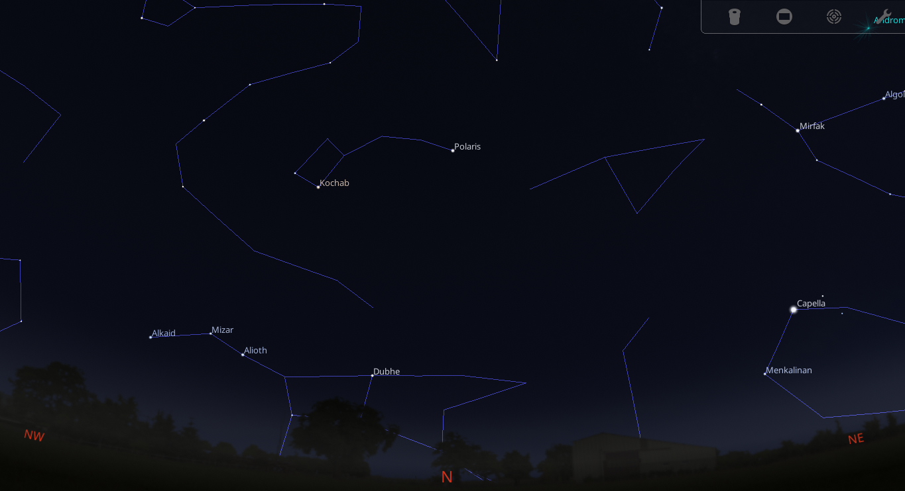
Notes:
Let’s apply some labels to these stars so that we can talk a little more about them. In addition to knowing your cardinal directions, another key skill is understanding object brightness. The ancient Greek astronomer Hipparchus attempted to rank the brightness of the stars, grouping the brightest stars into the “1st magnitude” classification. His second bucket was for stars half a bright, the “2nd magnitude” stars. He continued to the point where the faintest stars he could see were 6th magnitude stars. As the science of astronomy unfolded, we came to realize that Hipparchus’ efforts were a nice swag but not very accurate. Astronomers decided to select Vega, a bright star in our summer and fall skies, to be the standard for zero magnitude. They also defined one order of magnitude (e.g., from 0 magnitude to 1st magnitude) to represent a change of 2½ times in brightness. But Vega is not the brightest star in the sky – that honor goes to Sirius – so we end up with negative magnitude values for some stars to indicate they are brighter than Vega. In terms of just stars, we have Sirius at magnitude (-1.46) and the faintest stars most people can see from a dark sky at 6th magnitude. The key take away for new astronomers is that the higher the magnitude number, the fainter the object is.
[X] In our early evening sky shown here facing north, we see the brightest star is Capella rising over in the northeast. Capella checks in at magnitude 0.08 as the third brightest star in the northern sky.
[X] The handle of the Big Dipper and Polaris are made up of roughly 2nd magnitude stars, bright enough to be seen from most non-urban back yards.
[X] Many other stars, such as Pherkad in the bowl of the Little Dipper, check in at 3rd magnitude. These are often bright enough to still be seen in a suburban location.
[X] 4th magnitude stars, such as Epsilon Ursa Minoris in the handle of the Little Dipper, are often lost to observers living in our area. Light pollution overpowers them, requiring some sort of aid like binoculars to see them. As a new astronomer you should learn some strategies that you can use to try to see these fainter stars. First, try to locate a spot that is shielded from direct lights. Second, allow your eyes to become dark adapted by staying in the dark and avoiding looking at lights for 20 minutes. You can also try looking slightly off-center to your target (known as using averted vision) since that portion of your eye is more sensitive to light.
You may have noted that we called this star Epsilon Ursa Minoris rather than some tongue-twisting ancient name. A couple of points about that:
First, astronomer Johannes Bayer came up with the idea of labeling the stars in a constellation, from brightest to dimmest, using the Greek alphabet. So, the brightest star in the Little Dipper is Alpha, the second brightest is Beta, and so on. Given that Epsilon is the 5th letter of the Greek alphabet, we can infer that it’s the fifth brightest star of the constellation. But – that is not always true! There are constellations where the Beta star actually outshines the Alpha star. Still, it’s a convenient rule of them as to what stars are the brightest in a constellation

Slide 6
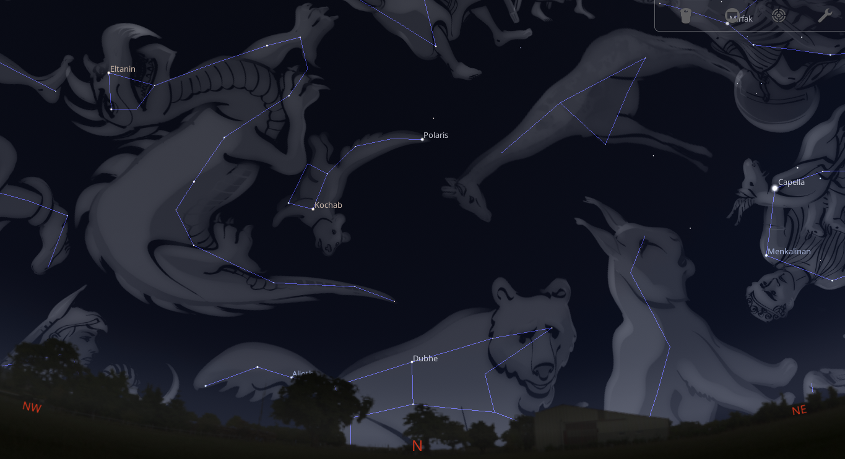
Notes:
Second, “Little Dipper” and “Big Dipper” are not constellations, they are asterisms – i.e., a collection of stars that make up a relatable pattern. In general, an asterism is a group of stars that a normal person would say, “Oh yeah, I can see that!” whereas a constellation can leave someone saying “How the heck did they think that looked like a bear!” So that star in the handle of the Little Dipper is part of the constellation Ursa Minor, which is Latin for “Little Bear”. Yep, the ancients saw that group of stars as a baby bear. I don’t know about you, but I’ve never seen bears with tails like that! Epsilon Ursa Minoris means the 5th brightest star of the constellation Ursa Minor.
One other point about asterisms is that they can cross constellation boundaries. For example, the asterism we call the Summer Triangle is composed of three bright stars from three different constellations.

Slide 7
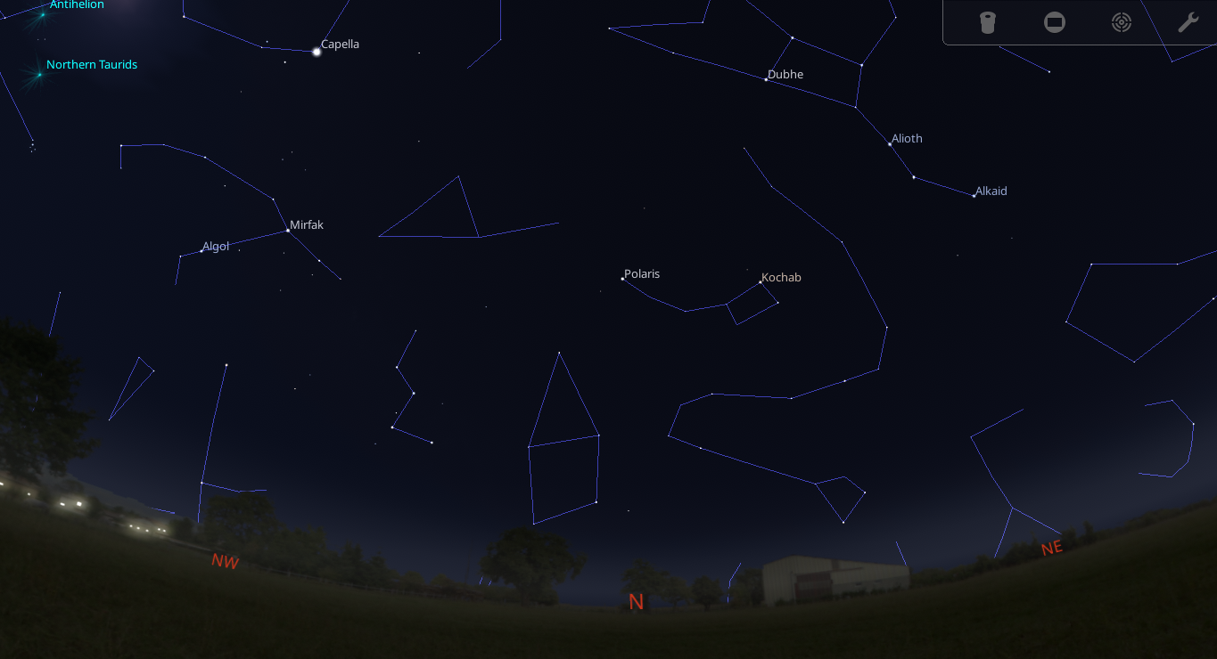
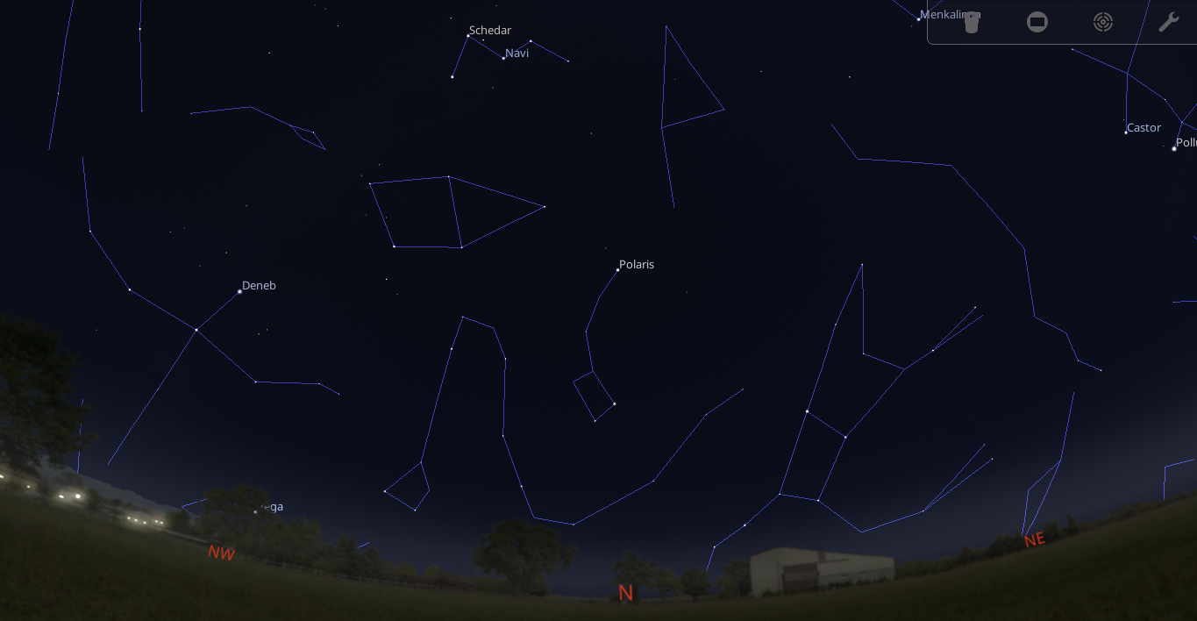
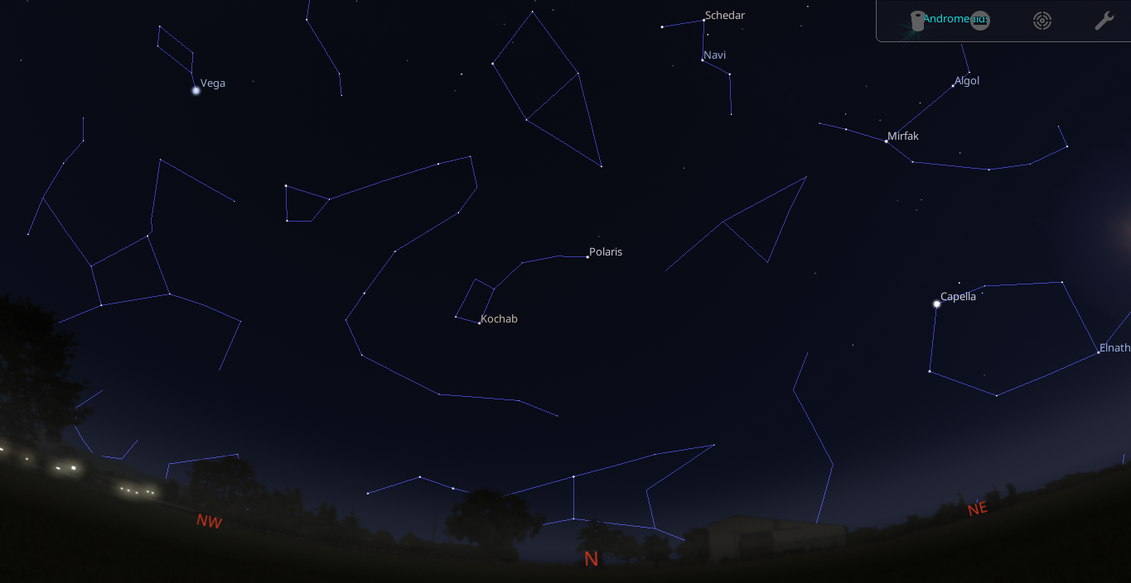
Notes:
Alright, so here’s a slightly wider view as we face North this evening a little after astronomical twilight has ended. Let’s say we go inside to watch some TV and come back out around 11pm.
[X] Here’s what we see now. The pointer stars of the Big Dipper have swung upwards and should be far easier to see. The bowl of the Little Dipper has swung down closer to the horizon, and bright star Capella is high above us overhead, actually moving outside the view we have here. We can see Cassiopeia – a familiar “W” asterism, is high in the sky above and to the left of Polaris. We turn in for the night and set the alarm for 5 am
[X] Venturing outside we now see the Big Dipper is high overhead, the Little Dipper’s bowl is now outstretched, and Cassiopeia has now swung below the pole star. Capella has started its descent from being overhead earlier and is in our field of view once again, but this time on the left (west) side of our sky.

Slide 8
Notes:
In this video, notice the Big Dipper on the right side. Also pay attention to where Polaris is. As we start the video, watch how the Big Dipper rotates about Polaris, with the North Star never really moving throughout this sequence.

Slide 9
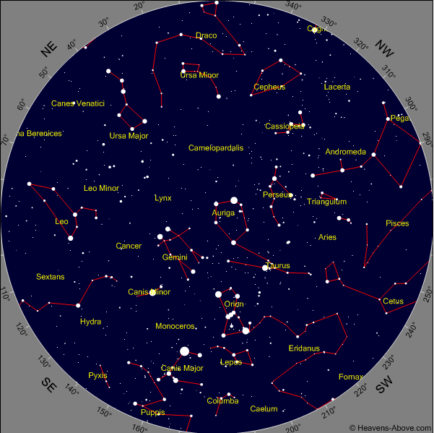
Winter Sky
Orion
Gemini
Taurus
Canis Major
Auriga
Canis Minor
Notes:
We’ve now covered the changes you’ll see in the night sky that unfold over the course of a night due to Earth’s rotation. Next, let’s explore the changes that are brought about by our planet’s orbit around the Sun by examining how our Maryland skies appear at midnight during each of the four seasons. We’re starting with Winter in our slide here, a view of the whole sky as it will appear at midnight on the Winter Solstice. Each season has a set of constellations that we associate with it. Those of the winter sky include Orion, Gemini, Taurus, Canis Major (and Minor), and Auriga. These are bold and bright constellations decorating the cold winter skies above.

Slide 10
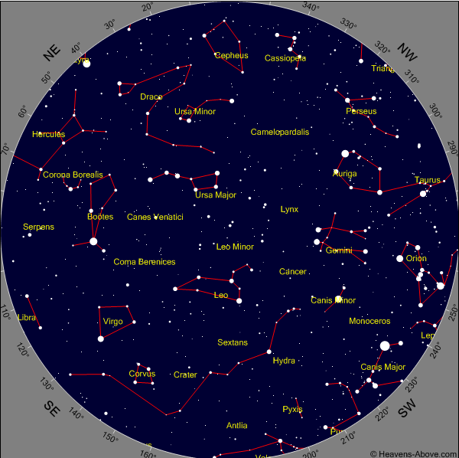
Spring Sky
Ursa Major
Leo
Bootes
Virgo
Hydra
Cancer
Notes:
As we come to the spring sky at midnight we have a new cast of constellations to take center stage; Leo and Ursa Major are overhead, while we also can include Boötes, Virgo, and faint Hydra on the springtime roster.

Slide 11
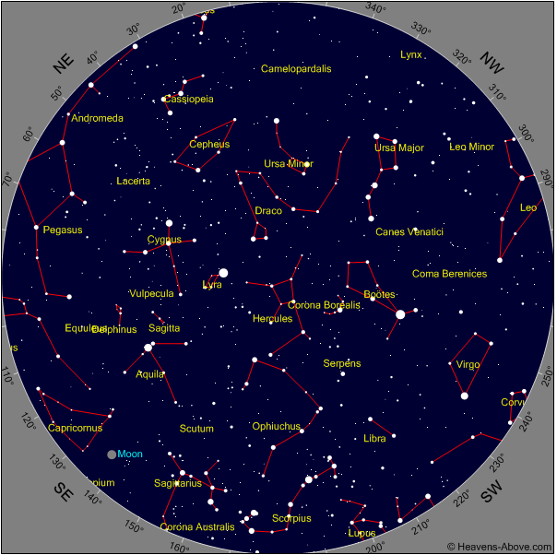
Summer Sky
Lyra
Aquila
Cygnus
Scorpius
Sagittarius
Libra
Notes:
Moving on to summer stars we have Lyra, Aquila, and Cygnus rising in the east at midnight on the summer solstice. These three each have bright 1st magnitude stars – Vega, Altair, and Deneb – that give us the Summer Triangle asterism. Farther south in our sky is Scorpius and Sagittarius.

Slide 12
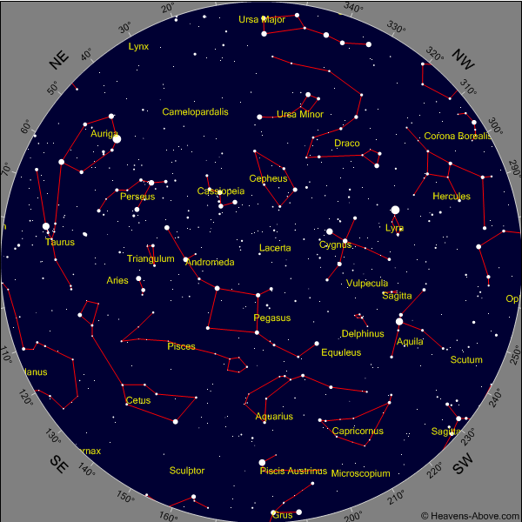
Fall Sky
Pegasus
Andromeda
Cassiopeia
Perseus
Aquarius
Pisces
Capricornus
Notes:
Wrapping up with the Autumn sky at midnight we see Cassiopeia, Pegasus, Andromeda, and Perseus take the stage to reenact their story of a young princess’ rescue (“Clash of the Titans”). We have two familiar asterisms in this sky – the “W” of queen Cassiopeia and the “Great Square” of Pegasus.

Slide 13
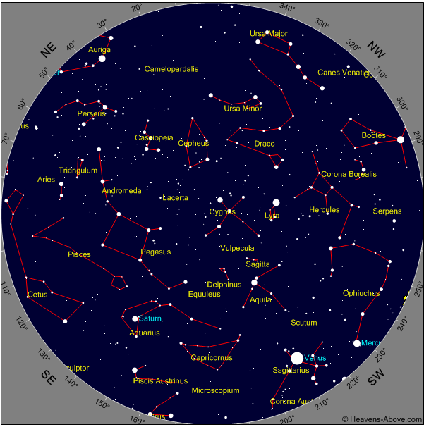
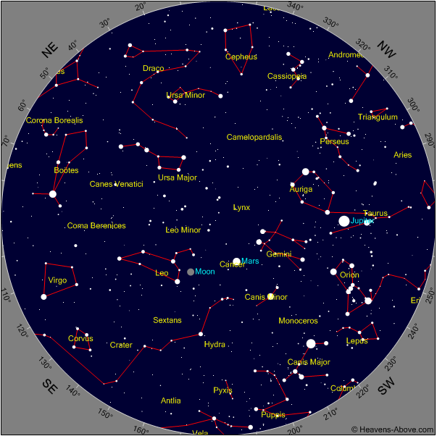
Notes:
Here on the left is the sky for this evening just after astronomical twilight, and then on the right just before astronomical twilight returns in the morning. Note that as the Earth rotates, we get to see the upcoming season’s constellations come into view in the east. We start off seeing the late summer constellations in the West after sunset, and right before dawn we can see the spring ones rising. So, in one night you can see roughly ¾ of the night sky.

Slide 14
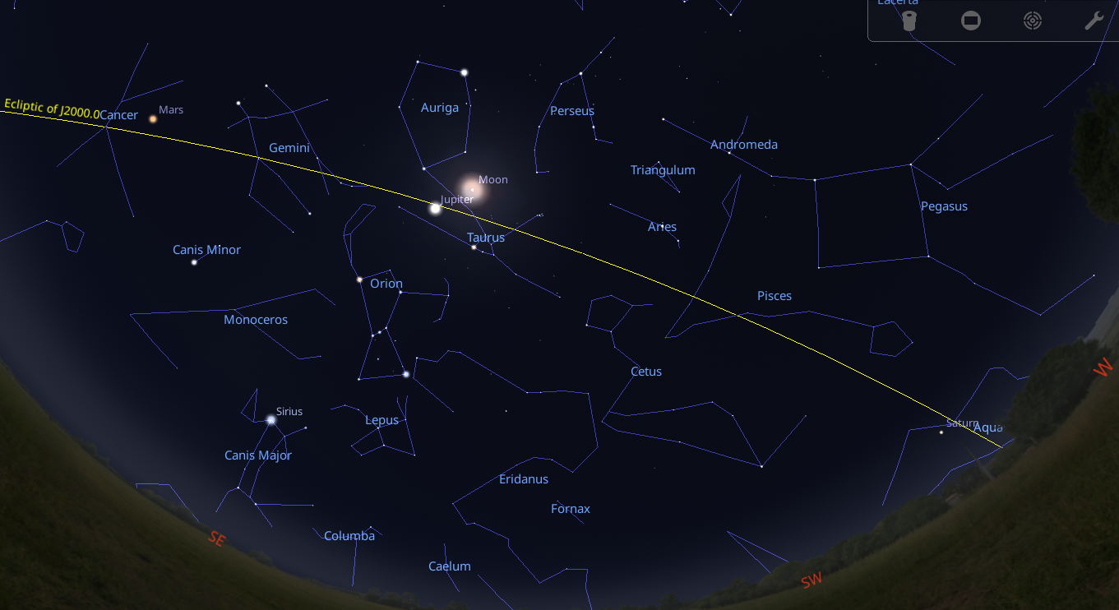
Zodiac
Notes:
Some of the constellations are special in that the Sun, Moon, and major planets are always found within them. These twelve are known as the Zodiac, and roughly approximate the plane of our Solar System. In this view of tonight’s sky around midnight, we can see the ecliptic (i.e., the plane of our Solar System) as a yellow line cutting through Aquarius, Pisces, Aries, Taurus, Gemini, and Cancer – 6 of the 12 Zodiac constellations. Notice that Aquarius is hosting Saturn, Taurus has Jupiter and the Moon, and Cancer is welcoming Mars. Earlier in the evening we could also find Venus among the stars of Sagittarius. The remaining 5 constellations of the Zodiac are Leo, Virgo, Libra, Scorpius, and Capricornus.

Slide 15
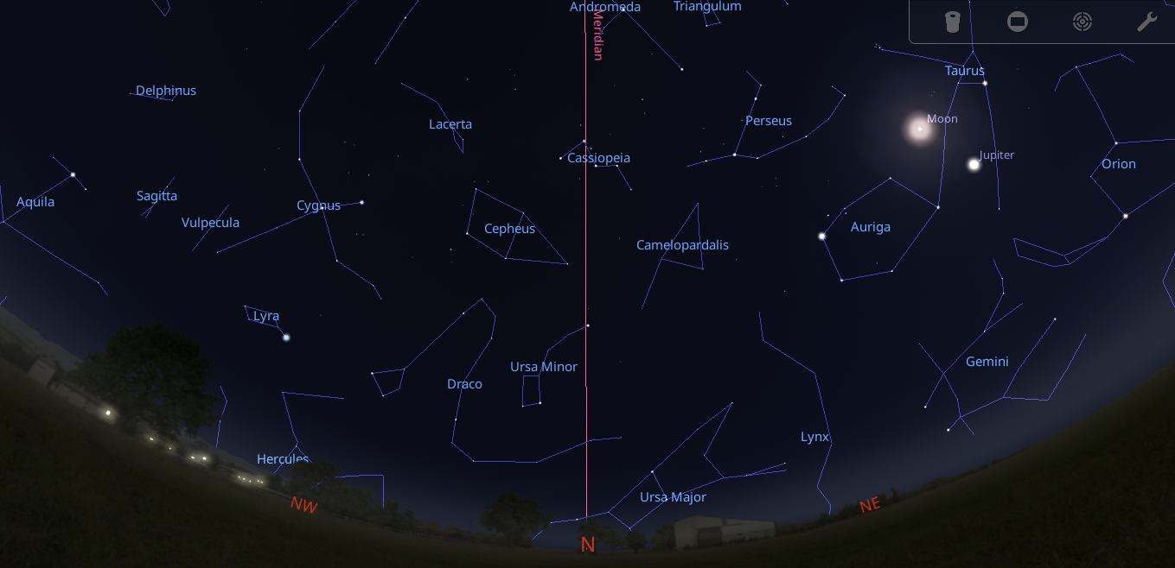
Central Meridian
Notes:
Another important imaginary line in the sky is the Central Meridian (or just “Meridian”). Think of this as dividing the sky above you into East and West halves. Draw a line up from the horizon through Polaris to the point of your horizon that is due South to form the Meridian. Notice how you are building on your skills here, using your knowledge of finding Polaris to help define the Meridian.

Slide 16
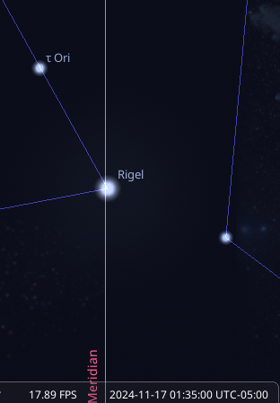
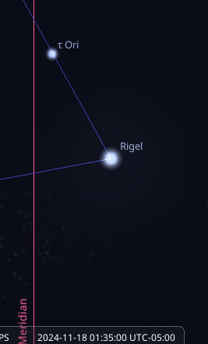
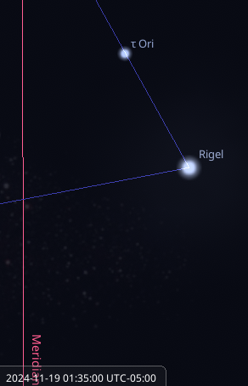
Central Meridian
The position of Rigel relative to the CM at 1:35 AM for November 17, 18, and 19th
24 hours * 60 = 1,440 minutes in a day
1,440 / 4 = 360 (the number of degrees in a circle)
4 minutes * 1 week = 28 minutes
4 minutes * 1 month = 2 hours
Notes:
We saw the large-scale changes of the positions of the constellations at midnight at 3-month intervals a couple slides back, but here we will examine the more subtle change from the impact that Earth’s orbital movement has over the course of just a day. On November 17th each year, the bright star Rigel in the constellation Orion reached the meridian at 1:35 a.m. The next night, at the same time we find it is a little west of the meridian, and the following night even further west. If you were to do an experiment, you would find that any star in the sky will reach the meridian roughly 4 minutes sooner each night.
[X] If we consider that there are 1,440 minutes in a day, and 360 degrees in a circle, we see why it advances by 4 minutes every night – doing so brings it back to the same spot a year later. It also has implications for you as an observer of the night sky; each week any given object will be back in the same position a half hour earlier; each month it’ll be there 2 hours earlier (on average). So, if you first notice Orion rising in the east at your home at 10pm tonight, in 2 weeks’ time it will be rising at 9pm.

Slide 17
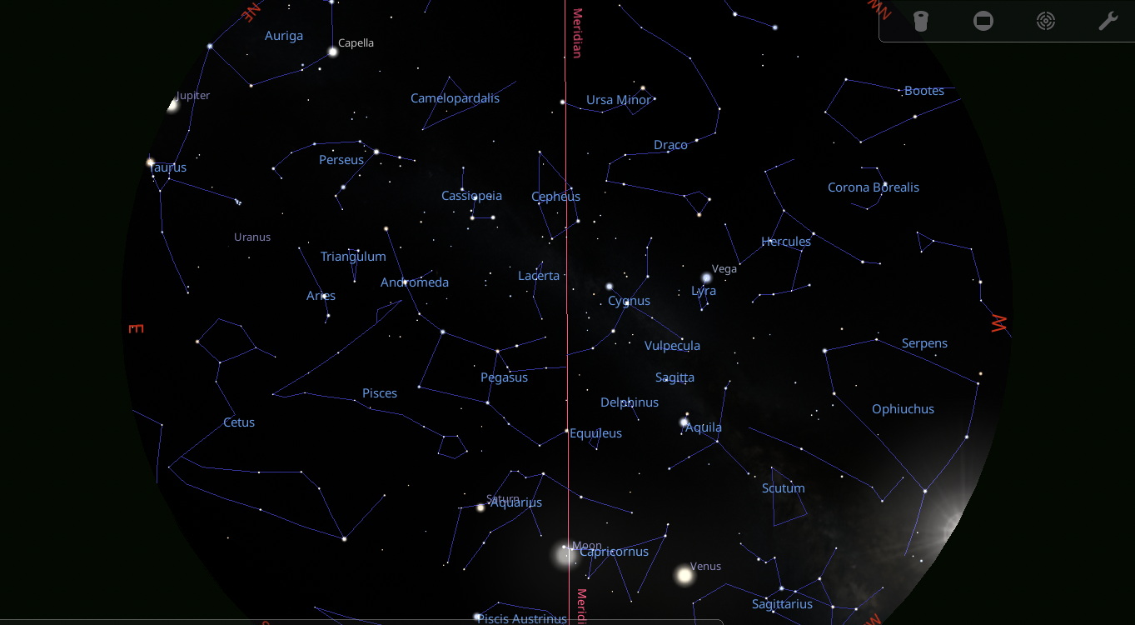
Opposition
Jupiter Rising
Sun Setting
Notes:
Another term that you’ll often hear is “opposition”. What this means is that the object that is at opposition is opposite the Sun in our sky; the object will be rising just as the Sun is setting. For example, here we see Jupiter rising on the evening of December 7th just as the Sun is setting. For many objects (but not all) an opposition represents the closest approach of the object to Earth (and usually its brightest appearance). Some objects, like Jupiter and Saturn, have an opposition once a year. Some, like Venus, never have an opposition because they lie inside Earth’s orbit (they will have a “greatest elongation”, i.e., their maximum distance from the Sun as seen in our sky)

Slide 18
Measuring the Sky
Notes:
As a night sky explorer, you will need to make sense of directions when someone says something like, “the Moon will be only 2º below Saturn tonight”. If someone tells you that two objects are separated by 5 degrees, just how big is that? Fortunately, there is a low-tech tool right at hand (pardon the pun). Extend your hand out and you will find
Your pinky width is about 1 degree
Your index, ring, and middle finger measure 5 degrees
An outstretched fist covers 10 degrees
And hanging loose sign gets you about 25 degrees

Slide 19
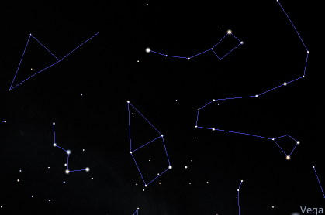
Learning Plan – Step 1
Identify the cardinal directions from your site (e.g., your yard)
Monitor sunset/sunrise
Compass (physical or phone app)
Locate the Cassiopeia (the “W” asterism)
Use Cassiopeia to find Polaris
Envision the meridian
Notes:
Armed with this primer of skills, what steps can you take starting this week to become night-sky confident?
[X] Start by confirming your cardinal dirstions, using the sun’s position or a compass (either actual or phone app)
[X] During the months of November and December, Cassiopeia is high in the northern sky. Step outside around 8pm, face north, and look up. You should be able to see an upside-down W in the sky.
[X] You can bisect the wider leg of the W to find Polaris. Make a note of it – it should be there in the same spot every night.
[X] Now that you have found Polaris, envision where the central meridian lies from your chosen observing location

Slide 20
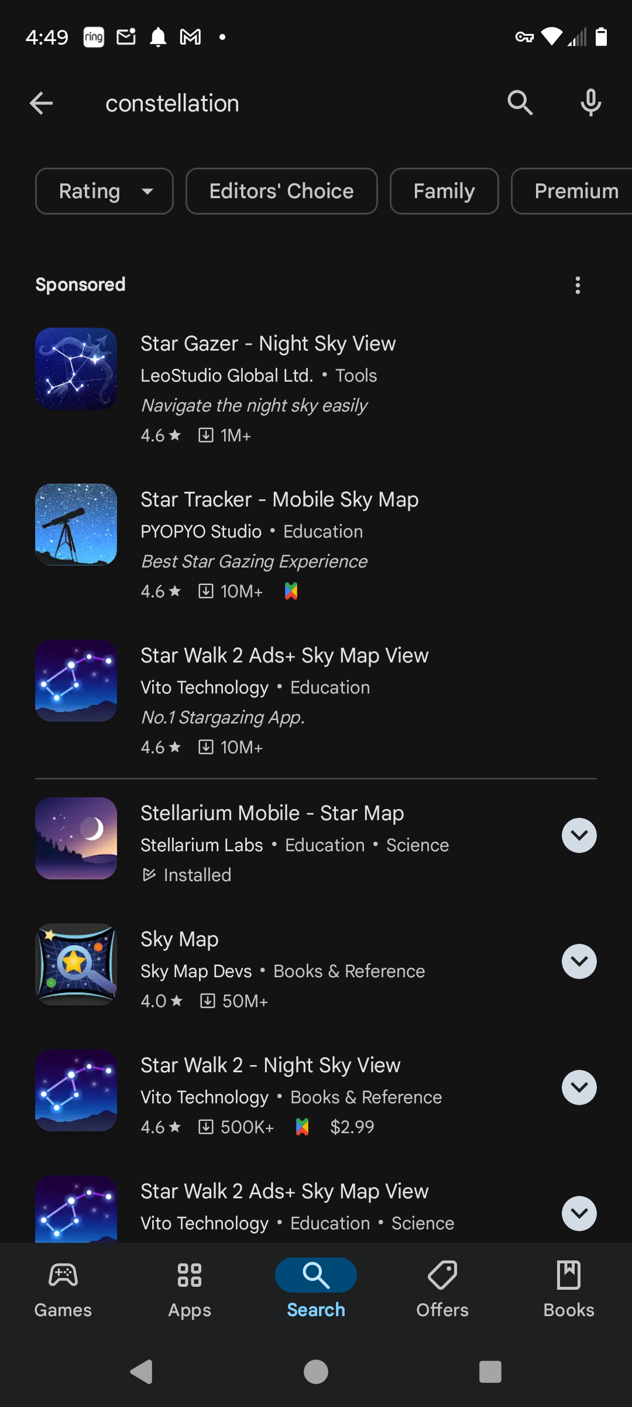
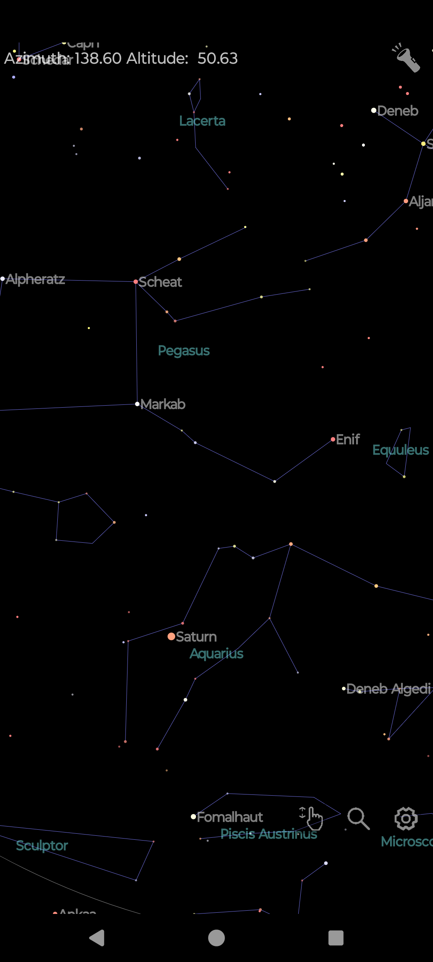
Get an App!
Notes:
A wonderful aid for learning the night sky is the availability of apps for you phone or tablet. Try searching for “constellation” and look over your options.
[X] These tools allow you to point your phone at the area of the sky and get a superimposed map to help identify what you are seeing

Slide 21
Learning Plan – Step 2
Let’s find some planets!
Soon after sundown look to the SW to find brilliant Venus
Try to find Saturn
It lies on the meridian as a 1st magnitude star this evening at 7 p.m. roughly halfway up from your southern horizon
The Moon joins Saturn on the evening of December 7th
Find Jupiter by stepping outside around 10pm and looking east for a bright star
Notes:
Let’s take the next step and identify some planets!
[X] This one should be quite easy – Venus is brilliant, shining at magnitude -4 in the SW sky after sunset
[X] Saturn is harder because it is not a standout like Venus, shining at magnitude 1. The good news is that there is nothing else that bright near Saturn, so it stands out from its celestial neighbors. Building upon the fact that you have a rough idea of the meridian’s location, you should be able to pick Saturn out lying about halfway up from the southern horizon along the meridian. Remember that each following night Saturn hits the meridian 4 minutes earlier, so in two weeks from now it’ll be on the meridian at 6pm. Another approach is to use the Moon. Both Moon and Saturn travel the ecliptic, so once a month the Moon will come close to Saturn in the sky. That next opportunity is December 7th where Saturn will lie a few degrees above and left of the Moon.
[X] Finally, head outside later in the evening around 10pm and face east. The brilliant star that you see (magnitude -2.8) is Jupiter; if you have binoculars, it’s worth checking out the planet as you will likely see a couple of stars very near the planet – the Galilean moons.

Slide 22
Learning Plan – Step 3
Let’s identify some winter constellations
Having identified Jupiter, we have identified Taurus
To the left of Jupiter and about the same height is an orange star - Aldebaran
Above and to the left of Jupiter is bright star Capella, part of Auriga
South and a little east of Jupiter is Orion – easy to recognize by the belt – 3 stars in a row.
Notes:
Next step – identify a few of the brighter winter constellations
[X] Stepping out at 10pm and finding Jupiter, we can explore other constellations. To start, Jupiter is in Taurus, so we can possibly make out that constellation’s V shape. The lucida of Taurus, orange giant Aldebaran, is to the right of the giant planet and at about the same altitude.
[X] Look high and to the left of Jupiter for very bright Capella, brightest star in Auriga
[X] Now look to the right and a little lower than Jupiter to find the iconic constellation of Orion with his three-in-a-row belt stars. Orion also has two 1st magnitude stars of Betelgeuse and Rigel

Slide 23
Learning Plan – Step 4
Targeting some bright Deep Sky Objects
The Pleiades (M45, Seven Sisters) is the best-known star cluster. Look for it about 20 degrees to the right and above Jupiter
Having found a rising Orion and his belt, look about 3 degrees south (right) of the belt for a glow. This is the famous Orion Nebula.
Both of these objects are more amazing if you have a pair of binoculars that you can use to check them out
Notes:
Now, let’s go a little deeper to some interesting targets
[X] Continuing with our late evening exploration, see if you can locate the Pleiades. It is an eye-catching tight cluster of six 2nd and 3rd magnitude stars occupying about a half degree of sky. It lies 20º above and to the right of Jupiter and looks a little like a tiny dipper.
[X] Let’s finish up with our most challenging object, especially for naked eye in suburban skies – the Orion nebula. We found Orion rising in the east and noted the three stars in a row marking his belt. A few degrees under the belt is a little glow that you might catch with dark-adapted eyes and averted vision – that’s the famed Orion Nebula
[X] If you have a pair of binoculars, you really should use them to get a much better view of these two fine objects.

Slide 24
Learning Plan – Explore!
It’s up to you now – use these skills to begin to identify all the major constellations that we talked about as well as all the stars that are 1st magnitude or brighter.
Follow the Moon as it visits the Zodiac constellations on its monthly journey.
Become aware of the relationship between our seasons and constellations seen at night - the rhythms of the sky that connect us to our ancestors.
Come out to a HAL star party to get answers to your questions!
Notes:
[X] With these fundamentals it’s up to you to, as Jack Horkheimer would say, “Keep looking up!” throughout the rest of the year. Make it a point that when you see a new star rising in the east that you pull up Stellarium or your phone app to identify it. Each month go outside and see if you can identify one or two new constellations that have arrived in the eastern sky.
[X] Keep an eye on the Moon as it traces out the zodiac on its monthly journey. Use it to reinforce the concept of an opposition at Full Moon where it is easier to notice that the moon rises as the sun sets when it’s a Full Moon.
[X] As the year unfolds become acquainted with the night sky associated with that season. You’ll have an appreciation and connection to our ancestors who used the same stars to tell them when to plant, when to harvest.
[X] Finally, don’t be a stranger! Come out to a HAL star party in 2025 to get your questions answered and to make new friends who also love learning about the heavens above.

Slide 25
Resources
Stellarium: https://stellarium-web.org/
Sky measurements by hand: https://nightsky.jpl.nasa.gov/news/236/
Bright Stars: https://www.farmersalmanac.com/10-brightest-stars
Lunar Calendar: https://alpo-astronomy.org/Lunar
Notes:
Resources

